Slide 1

Mind Reader
Next Word Prediction App
CAPSTONE TERM II
AIDI Winter 2022 Section A

Slide 2

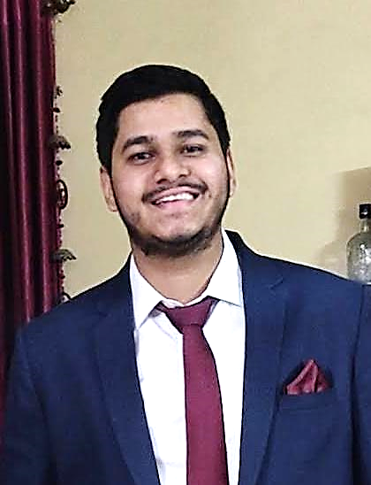
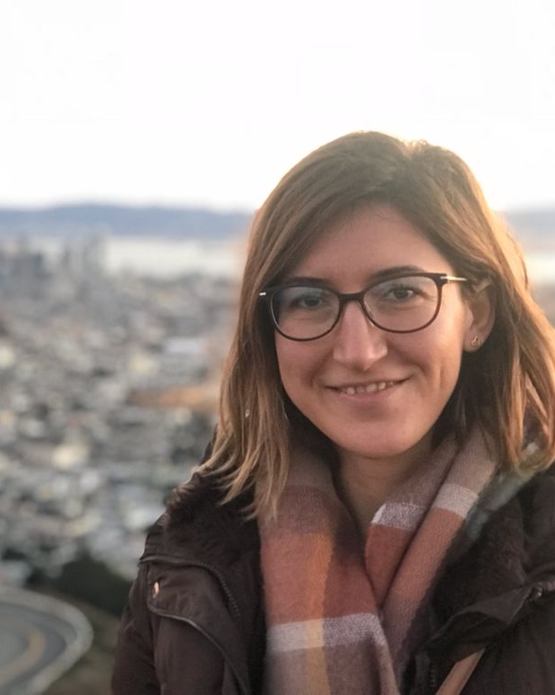
Meet Our Team
Abhishek Joshi
Esra Ersoy
I’m an Engineer by profession and I’m passionate about Data. Studying this field to explore more and more how this works.
My bachelor's degree is in Mathematical Engineering. And I worked as business analyst in software development projects in Turkey.

Slide 3
Project: Next Word Prediction
OBJECTIVE
The goal of our project is to build predictive text models like those used by SwiftKey, an App making it easier for people to type on their mobile devices by predicting the next word that is most likely to come. In this project, text data from blogs, twitter and news will be downloaded and a brief exploration and initial analysis of the data will be performed.
TECHNOLOGY
1. Source: Blogs, articles dataset from Kaggle or other sources.
2. Python (User Interface design)
3. Python (AI model programming)
4. AWS (cloud storage for database and codes) or Azure
5. GitHub (Version control)

Slide 4
Project Definition
SCOPE
MUST HAVES:
✓ User based application. Each user history will be kept in database.
✓ An input textbox for user to type the message.
✓ Shortest Path Algorithm or LSTM will be applied.
✓ Domain based articles will be used for the project. (Close scope)
✓ Suggestion of 3 possible words. If the user choose one of the suggestions, it will be saved on database.
✓ Percentage of the successful suggestions (number of accepted words by user / total number of suggested words) will be measured and displayed under the user name.
NICE TO HAVES:
✓ Auto complete feature
✓ Category based training and prediction
✓ Suggesting phrases instead of single words

